Slide 1
CS 341 Lab 9
FALL 2020

Slide 2
Lab 9
Goal: Determine whether an object is moving closer or away

Slide 3
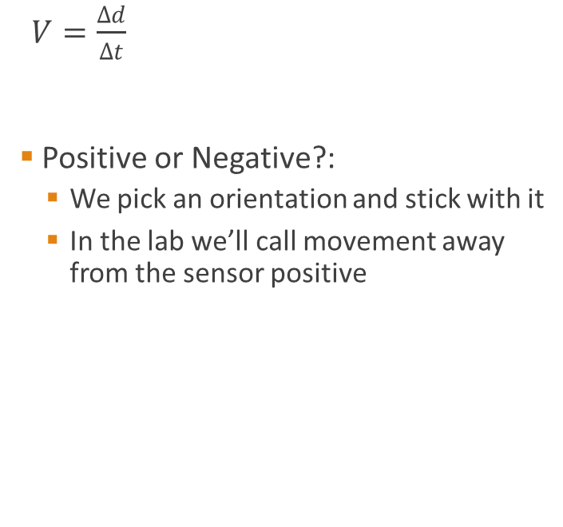
Velocity
Distance d

Slide 4
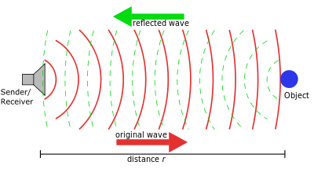
Sonar
-Sonar uses ultraviolet waves to “see”.
-In the sense of noise, ultraviolet waves are an inaudible sound at a very high frequency. -The sonar can detect the distance between an object and itself by sending a sound wave than measuring the time it takes to receive a reflected wave caused by hitting an object.
-All sound waves travel the same speed in a given medium. Ex sound waves travel 343 meters per second in air.
-So, using this we can calculate the distance between the the start of the wave and the object.
-The time represents both our time to the object and time back, we only care about time to.
-Velocity = change in distance over change it time.
-If we isolate distance and factor in the constant speed of sound waves in air, we get D = (change in time/2)*343

Slide 5
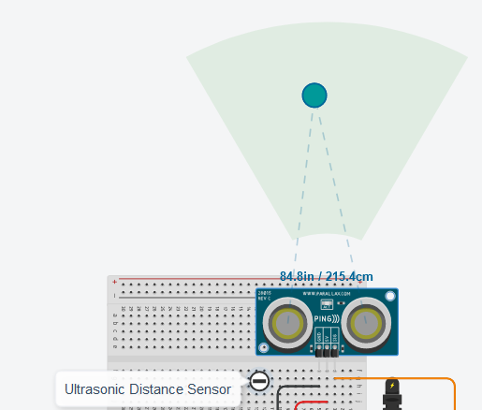
Distance Sensor
inputs a digital input
High means send out a signal
Low means don’t send a signal
outputs a digital signal
The length of this signal is equal to how long the it took to get a response
Make sure to use the sensor with 3 pins (not 4). Pin to send power, turned on by digital input. Pin to complete circuit. Pin to send start ping out. pin to listen to signal from sensor.

Slide 6
Ping()
int ping(int pingPin) {
int duration;
pinMode(pingPin, OUTPUT);
digitalWrite(pingPin, LOW);
delayMicroseconds(2);
digitalWrite(pingPin, HIGH);
delayMicroseconds(5);
digitalWrite(pingPin, LOW);
pinMode(pingPin, INPUT);
duration = pulseIn(pingPin, HIGH);
return duration / 29 / 2;
}
PulseIn
Returns the pulse width (length of time in ms a digital pin is high for)
Analog input
Value between [0, 1023] based on voltage in [0, 5V]
Send a signal out
Record time
Divide by V_{sound}⁻¹
Divide by 2

Slide 7
Lab 9
The starter code already finds the distance of an object
use the ping() function to estimate the velocity over time
Suggestion: calculate velocity as a float

